Slide 1
POLS 207 State & Local Government*
Chapter 10B
Executing the Laws and Leading the People
Dr. Roblyer, Ph.D.
*These slides are based on originals provided by Dr. Harvey Tucker

Slide 2
Learning Objectives
Explain the term “plural executive,” its origin, and what it means for political power in Texas. Describe how “mavericks loose on the range” can be an apt analogy.
Describe the legislative and executive powers of the Lieutenant Governor in Texas. Provide examples.
Compare and contrast the power of the lieutenant governors across the states and with respect to the power of governors. Pinpoint the ranking of the Texas #2, how the position compares to the governor’s, and describe the measure used.
Describe the office and role of the Texas Comptroller.
Describe the office and role of the Texas Land Commissioner.
Explain how and why state lands are used to general revenue for education in Texas.

Slide 3
Learning Objectives
Describe the offices and role of the Railroad Commission. Differentiate the RRC from the General Land Office when it comes to energy production.
Describe the office and role of the Texas Agricultural Commissioner.
Describe the office and the role of the Texas Attorney General.
Explain the role of attorneys general in increasing the influence of states nationally.
Describe government bureaucracies, bureaucratic agencies, and bureaucrats and their growth over time.
Discuss the advantages held by bureaucracies over their elected and appointed bosses.
Explain why bureaucracies tend to survive.

Slide 4
Approach to this Chapter
Governor – Texas Style
Plural Executive – Mavericks Loose on the Range
Lieutenant Governor – Biggest Hombre in Tejas
Comptroller
Land Commissioner
Railroad Commission
Agricultural Commissioner
Attorney General
Bureaucracy – Blossoming under “Small Government” fertilizer

Slide 5
Plural Executive: Mavericks Loose on the Range
Other statewide elected officials in executive branch
Many powers typically in hands of one office are spread across multiple elected offices, commissions, and boards
This dispersal done intentionally in TX Constitution to create an institutionally weak chief executive—Texans didn’t want a king
Key statewide-elected leaders:
Lieutenant Governor
Comptroller (now also incorporates “Treasurer”)
Land Commissioner
Railroad Commission (3 seats)
Agricultural Commissioner
Attorney General

Slide 6
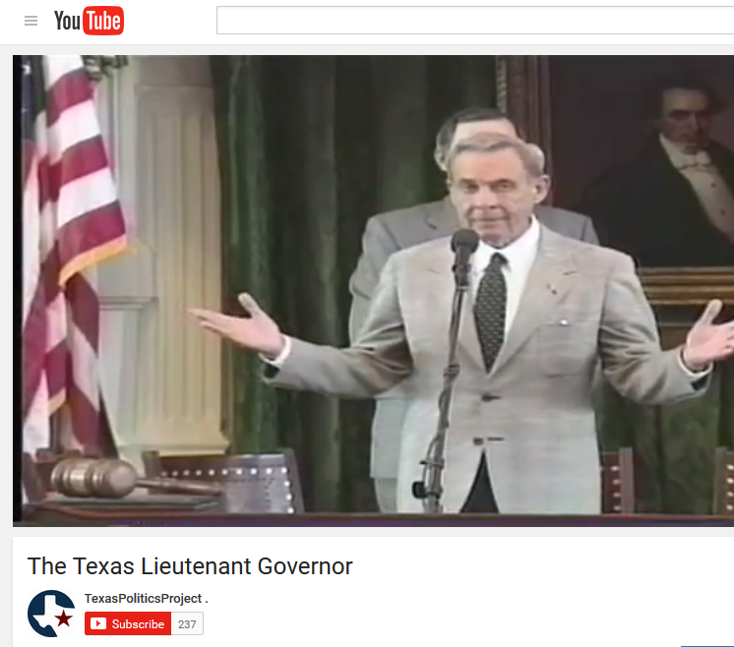
Lieutenant Governor: El hombre grande de Tejas
Plural Executive Unpacked
Widely accepted as most powerful government position in the State of Texas
Formal-power “voids” in Governor office inversely reflect the formal-power strengths of Lt. Governor
Elected separately
Not a paired “ticket” with governor on ballot
Sometimes from different party than governor
Interviews with former officeholders: (8:37)
https://youtu.be/tq59rCvUy8I
Watch this!
Notes:
http://youtu.be/ET-A_Dg4nNs?list=UUSJDmveVFIeJxm3QOIYHTQQ

Slide 7
Lieutenant Governor and the Legislature
Most powerful legislator: “Legislator in Chief”
4-year term; often builds power by being re-elected repeatedly
President of Texas Senate – leads, oversees all proceedings
Great deal of influence over policy and content of laws
Spends significant time, energy building alliances, outmaneuvering opponents
Not a senator!
Appoints Senate committees
Can differentiate between own party/other party; friends/enemies
Assigns Senate bills to commitees: determines bills’ futures
Much leeway under rules of Senate; multiple eligible destinations
Reward/punish members, sponsors, committees, interest groups

Slide 8
Lieutenant Governor and the Legislature
More powerful positions still…
“Co-chair” of 10-person Legislative Budget Board
Drafts budget, sets policy starting point
Chair of Legislative Council
Investigates agencies, recommends legislation, conducts studies
Member of 5-person Legislative Redistricting Board
“Gerrymanderer-in-Chief”?

Slide 9
Lieutenant Governor and the Executive Branch
Executive-type functions almost don’t exist
Governor focuses appeals on citizens, but Lt Governor often focuses on state senators first
Does serve as acting governor when elected governor is out of the state or incapacitated
Can provide important experience and exposure functioning as executive instead of legislator
Assumes office if governor resigns, dies, or is unable to serve out the term

Slide 10
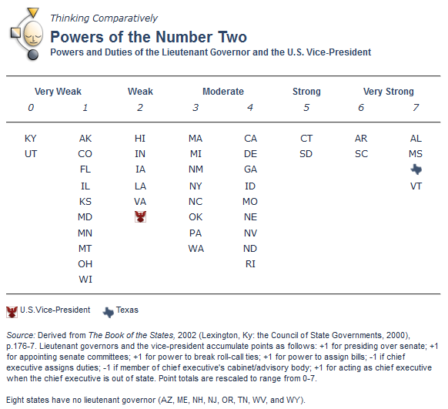
Comparing the State’s #2s
+1: Presiding
over Senate
+1: Appointing
Senate committees
+1: Power to break ties
+1: Power to assign bills
+1: Acts for governor when absent
-1: Governor
assigns duties
-1: Member of governor’s cabinet
8 states don’t have a lieutenant governor
http://www.laits.utexas.edu/txp_media/html/exec/features/0902_01.html

Slide 11
Comptroller
Plural Executive Unpacked
4-year term
Incumbent: Glenn Hegar
Aggie, Attorney, former member of State House & Senate, former chair of Sunset Advisory Commission
Broad financial responsibilities make this a powerful office
Tax collection, accounting, check writing, audits
Treasurer of state funds and investments
Estimating revenue for the state
Balanced budget requirement in Texas puts this official right in the middle of the budget process
Legislature can’t spend more than comptroller says it can!
Key office “at crossroads” of key policy areas
Multiple incumbents have jumped from here to higher state office (e.g., Bob Bullock)

Slide 12
Land Commissioner
Plural Executive Unpacked
4-year term; heads General Land Office
Incumbent: Dr. Dawn Buckingham, M.D. 7th-generation Texan, self-made small business owner, plastic surgeon, state senator, hunter, outdoorsman
Power derives from managing large amount of public lands and resources (energy!) found there
Issues permits for exploration & for exploitation
Collects royalties on oil, gas extracted—all valuable state revenues
Other diverse duties:
History and archives
State lands
Coastal, protection, emergency response
Veterans Land Board (state-level veterans affairs)

Slide 13
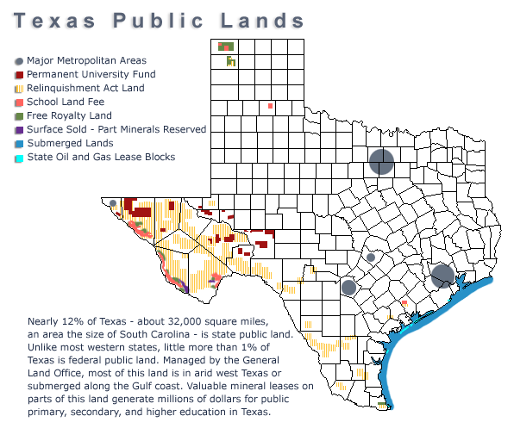
Where are the managed lands?
http://www.laits.utexas.edu/txp_media/html/exec/features/0905_01.html

Slide 14
Permanent Funds
State government set aside millions of acres of state lands in the late 1800s
Purpose of these lands was to generate revenue to indirectly fund primary, secondary, and higher education in the state
Lease payments and royalties are invested, then the interest earned is distributed according to state law
Only interest is ever spent from these accounts (hence the permanence of these funds)
Two largest of these funds:
Permanent School Fund ($34B in 2014, for public elementary & secondary schools)
Permanent University Fund ($18B in 2014) for UT and TAMU main and system campuses)
Notes:
Texas Higher Education Coordination Board’s white paper on PUF and HEAF: www.thecb.state.tx.us/reports/PDF/0434.PDF
PUF Semi-Annual Financial Report (Dec 2014): http://www.utimco.org/Funds/Endowment/PUF/PUFSemiAnnual201412.pdf

Slide 15
Railroad Commission (RRC)
Plural Executive Unpacked
3 commissioners, 6-yr staggered terms
Incumbents: an attorney, a business owner, and an rancher-energy-exec, all very friendly with the Texas oil/gas industry
Very powerful body in Texas government
Better, more descriptive name would be “Energy Commission”
Regulates oil, gas, trucking, mining (not railroads since 1980s)
Oil/gas represents 60% of industry in Texas
In 2013, Texas would have been in the top 15 oil-producing nations, if broken out separately from the U.S.
Clarification on roles of the RRC & General Land Office
GLO handles the “who,” “when,” and “where” of energy extraction
RRC watches over the “how” and “what:” Ensures that technologies are approved and properly implemented, and that laws and regulations of the state are followed
Notes:
Hey Dr. Roblyer, I have a Question regarding chapter 10. Why does the RRC play a role in the ongoing conflict surrounding fracking and not the land commissioner? I think it is because they are dealing primarily with the people's complaints.
DAR: The RRC is the right answer for two reasons:
1. The GLO plays no role in determining or controlling the technology that a company may use during the extraction process. The GLO simply grants permission for a certain company to extract a certain product at a certain location. It is the RRC that regulates the “how it is done” part of the extraction. Therefore, fracking (as well as more traditional methods) is overseen as a process by the RRC.
2. The RRC is a regulatory body and the GLO is not. In this role, the RRC writes the regulations that control when fracking can be used and how it must be done (or not done). State residents with complaints about fracking operations that are negatively impacting themselves or their community must turn to the regulatory agency that is in charge of writing the rules and enforcing the rules and pertains to those operations.

Slide 16
Agricultural Commissioner
Plural Executive Unpacked
Incumbent: Sid Miller (Legislator in Texas House of Representatives, rancher, horticultural nursery owner, school board member)
4-yr term; heads Texas Dept of Agriculture
Source of power: Enforces all agricultural state laws for nation’s 2nd leading agricultural producer
Food inspection, promotion of exports
Animal quarantine, disease, pest control
Inspection of gas pumps for accuracy (legacy of duties regulating weights, measures)

Slide 17
Attorney General
Plural Executive Unpacked
4-yr term as chief lawyer for state
Incumbent: Ken Paxton (attorney, former member of Texas House & Senate, co-sponsor of recent voter ID bill)
Role is mainly civil, not criminal
Files suit for state; defends state when sued
Example: Suit against major tobacco companies in 1990s
Most law enforcement & criminal issues handled at city/county levels, not by AG
AG candidates still tout their crime-busting credentials to voters, though

Slide 18
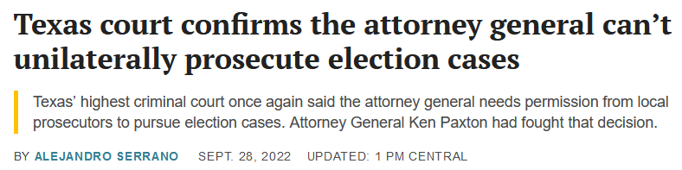
Attorney General
Plural Executive Unpacked
4-yr term as chief lawyer for state
Incumbent: Ken Paxton (attorney, former member of Texas House & Senate, co-sponsor of recent voter ID bill)
Role is mainly civil, not criminal
Files suit for state; defends state when sued
Example: Suit against major tobacco companies in 1990s
Most law enforcement & criminal issues handled at city/county levels, not by AG
AG candidates still tout their crime-busting credentials to voters, though
https://www.texastribune.org/2022/09/28/attorney-general-ken-paxton-voter-fraud/

Slide 19
Attorney General
Source of power: formal opinions (interpretations) of legality or constitutionality of proposed or enacted laws can make major impacts on public policy
Have effect of law unless altered/overturned by legislature or a court
Example: Following single-school, single-degree-program Hopwood decision, TX AG generalized in his opinion that all programs within all Texas public higher education institutions must cease affirmative action
Great launching point for higher office
Previous AG, Greg Abbott, is now governor
Before Abbott was John Cornyn, now senior U.S. Senator (R-TX)
http://www.nytimes.com/1997/03/26/us/texas-told-keep-affirmative-action-universities-risk-losing-federal-aid.html
Notes:
http://www.nytimes.com/1997/03/26/us/texas-told-keep-affirmative-action-universities-risk-losing-federal-aid.html

Slide 20
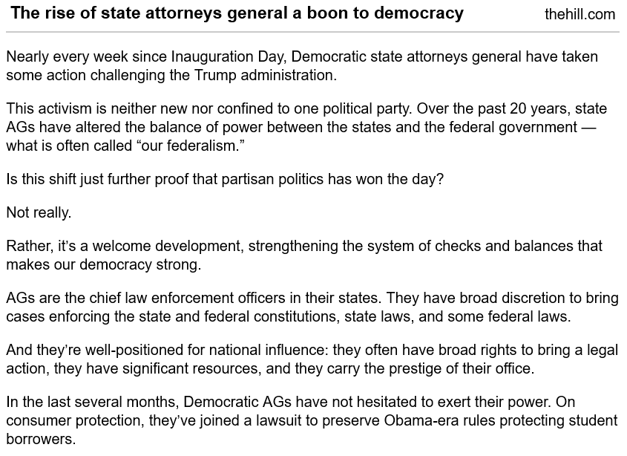
Attorneys General flexing muscles across the U.S.
Source o
http://thehill.com/blogs/pundits-blog/state-local-politics/340841-the-rise-of-the-state-attorney-generals-is-boon-to

Slide 21
Approach to this Chapter
Governor – Texas Style
Plural Executive – Mavericks Loose on the Range
Lieutenant Governor – Biggest Hombre in Tejas
Comptroller
Land Commissioner
Railroad Commission
Agricultural Commissioner
Attorney General
Bureaucracy – Blossoming under “Small Government” fertilizer

Slide 22
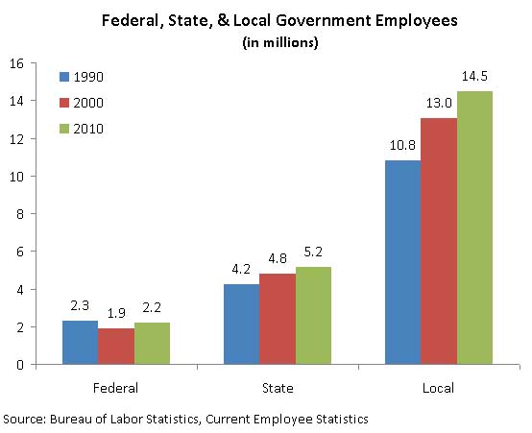
State Bureaucracies Have Grown
What does this say about the correct focus of “big government” debates?
Can governors credibly criticize federal government growth?
http://www.cato.org/blog/growth-government-employment

Slide 23
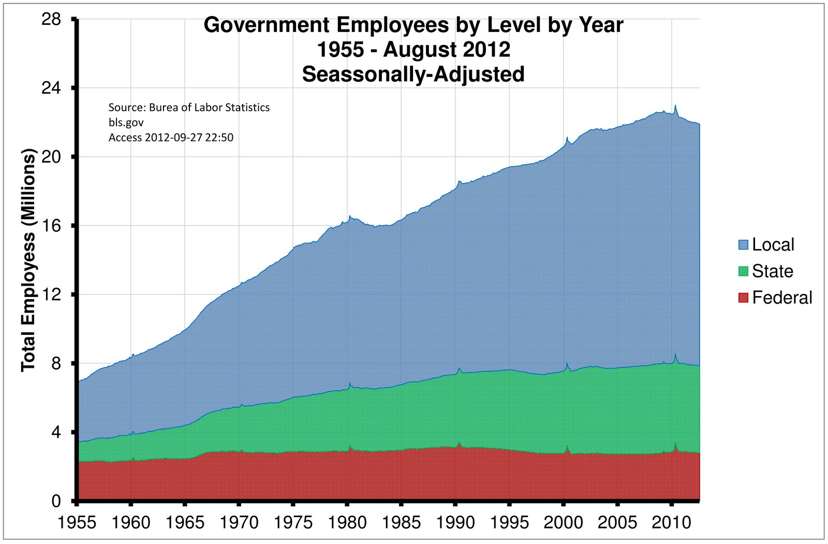
State Bureaucracies Have Been Growing for Some Time
What are these?
Where federal employment does not include military or intelligence personnel
https://econotb.wordpress.com/2012/09/27/growth-in-federal-government-employees-pales-next-to-state-and-local/comment-page-1/

Slide 24
Advantages of Agencies and the Bureaucrats that Staff Them
Information:
Staff members are in-house experts with command of very large amounts of information
Time:
Staff usually takes the “long view” of both history and future
Not much is new to them—can predict outcomes
Willing to wait—not going anywhere!
Able to outwait elected officials and their term of office

Slide 25
Advantages of Agencies and the Bureaucrats that Staff Them (cont’d)
Procedures
Agencies write them, so they will usually give advantage to the agencies
Clientele
Usually support the agency staff members (because the staff will be the ones who stay)
Solid basis (…or roots)
Constitutional or statutory foundation
Much of what agencies do cannot be changed without changing the law

Slide 26
Bureaucratic Agencies in Light of Organization Theory
Self Interest model of organizational behavior applicable
Employees want to perpetuate, grow organization for 2 reasons:
Benefit themselves
Continue offering worthwhile goods, services to increasing client base in face of growing problems
Mission < (Survival + Growth)
Mission subjugated to survival, growth
If mission met (problem solved), they redefine mission
Example: March of Dimes conquered polio, switched to fighting birth defects
https://www.marchofdimes.org/history-march-dimes

Slide 27
Executive Branch of Texas: Doing it the Texas Way!
Governor who has no broad powers over much of the business of state government
Legal system
State budget and finances
Education
Transportation
Lt Governor who is primarily a super-legislator, and more “sheriff” than “deputy”
Functions as executive only when governor is out of state
“Plural Executive” that altogether has got all the powers the Governor ain’t got
Directly elected and not responsible to the governor
Agriculture
Public utilities
Land development
Natural resources
…And none of these here folks have to belong to the same party or even share the same policy agenda!

Slide 28
Practice Problems …to begin mastering this material. Complete instructions are in the Module 1 resource, How to Use Practice Problems to Prepare for Exams.
Don’t forget to do the…

